Slide 1

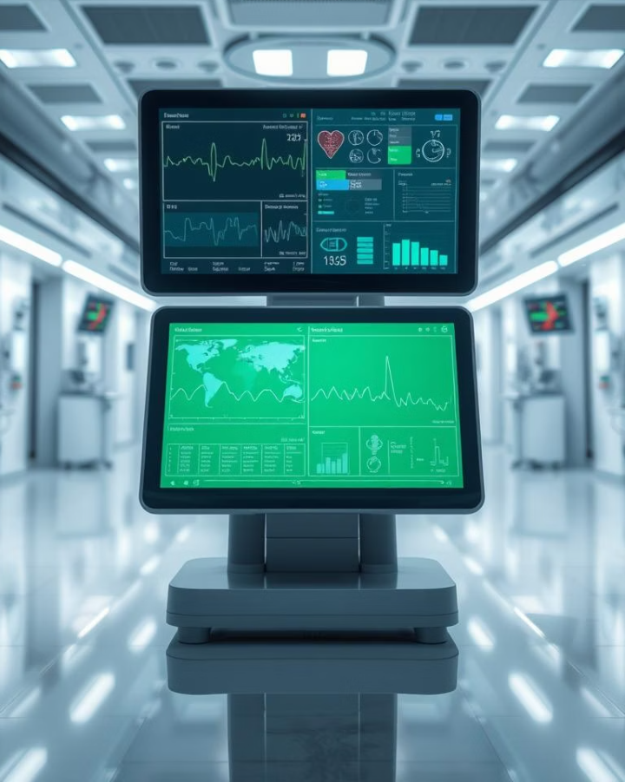
Health Monitoring System
Real-Time IoT-Based Vital Sign Monitoring and ML-Based Health Risk Prediction
Submitted by: Nitesh Kumar, Vishal Saini Submitted to: Mr. Sharad Kumar Singh Department of Cyber Security, COER University, Roorkee Session: 2024-2025

Slide 2
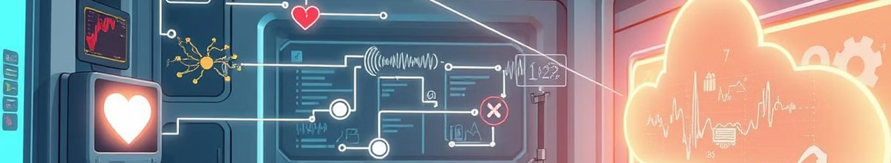
Table of Content
Introduction
System Requirement
Technology Used
Methodology
Conclusion
Future Work

Slide 3
Introduction
In this project, Health Monitoring System, we built a device using IoT sensors and machine learning. It captures vitals like heart rate, SpO₂, temperature, and respiratory rate when the user places a finger and arm on sensors. After entering basic details, the system sends data to an ML API which predicts health risk and shows possible conditions. It’s simple, smart, and helps in early health assessment.

Slide 4
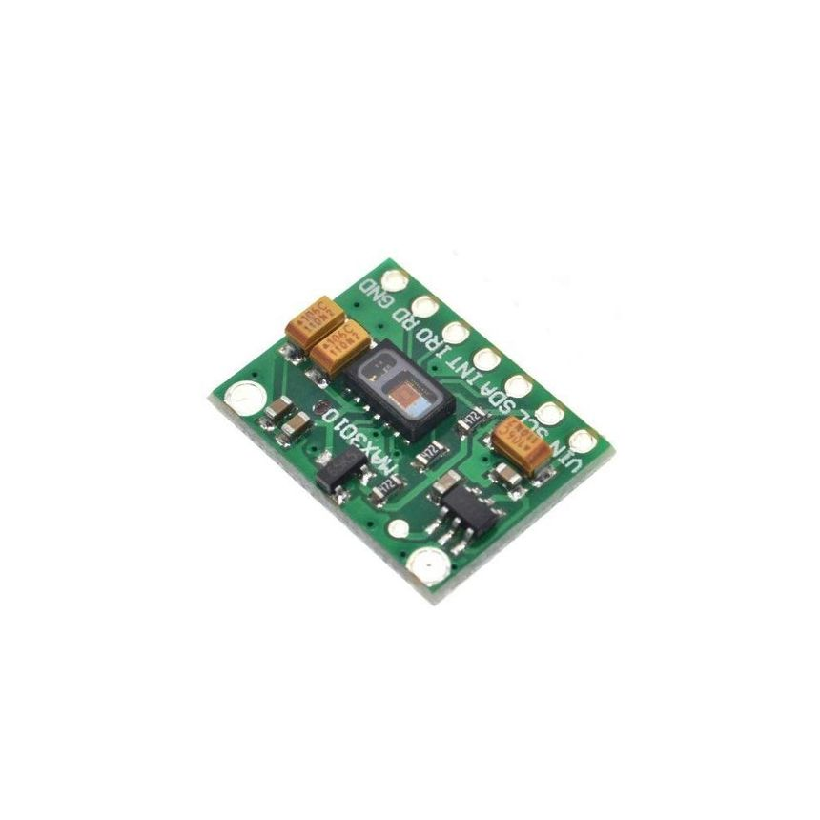

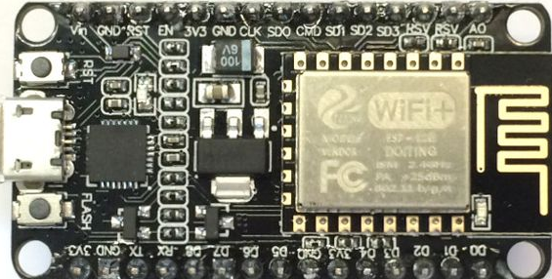
System Requirements
Hardware | Software | Other
NodeMCU ESP8266 MAX30102 (Heart Rate, SpO₂) DS18B20 (Temperature) | Arduino IDE Firebase (Realtime DB) Flutter SDK Python + Flask Render (API Hosting) | Internet Connectivity Android/iOS device

Slide 5
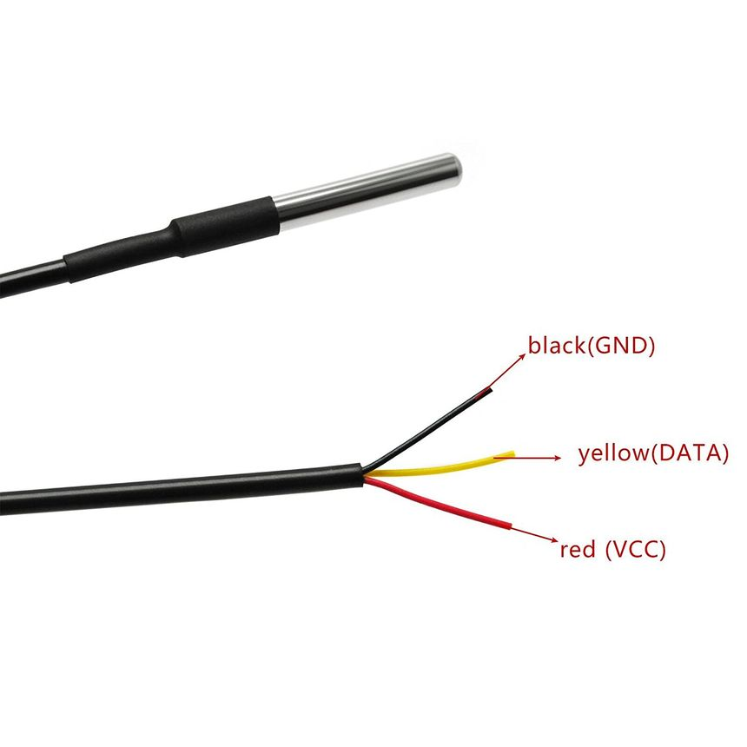
Technology Used
Component | Technology / Tool | Purpose
Microcontroller | NodeMCU (ESP8266) | Captures sensor data and sends it to the cloud
Sensors | MAX30102, DS18B20 | Measure Heart Rate, SpO₂, and Body Temperature
Programming Language | Arduino C++ | Firmware development for microcontroller
Development Environment | Arduino IDE | Writing and uploading code to NodeMCU
Cloud Database | Firebase Realtime Database | Secure, real-time storage of sensor data
Mobile Framework | Flutter (Dart) | Cross-platform mobile application development
App Libraries | Firebase SDK, Sensor Libraries | Interface NodeMCU with sensors and Flutter app with Firebase

Slide 6


Technology Used
Component | Technology / Tool | Purpose
Dataset Source | Kaggle | Health datasets for ML model training
Programming Language | Python | Machine learning model development
ML Libraries | Scikit-learn, Pandas, NumPy, Pickle | Data preprocessing, model training, and serialization
ML Algorithms | Logistic Regression, Random Forest, SVM | Model training and evaluation
API Development | Flask | REST API to expose the ML model
Hosting | Render | Hosting the Flask API online
App Integration | Flutter (HTTP package) | Connects mobile app to Flask API in real-time

Slide 7
Methodology
e

Slide 8
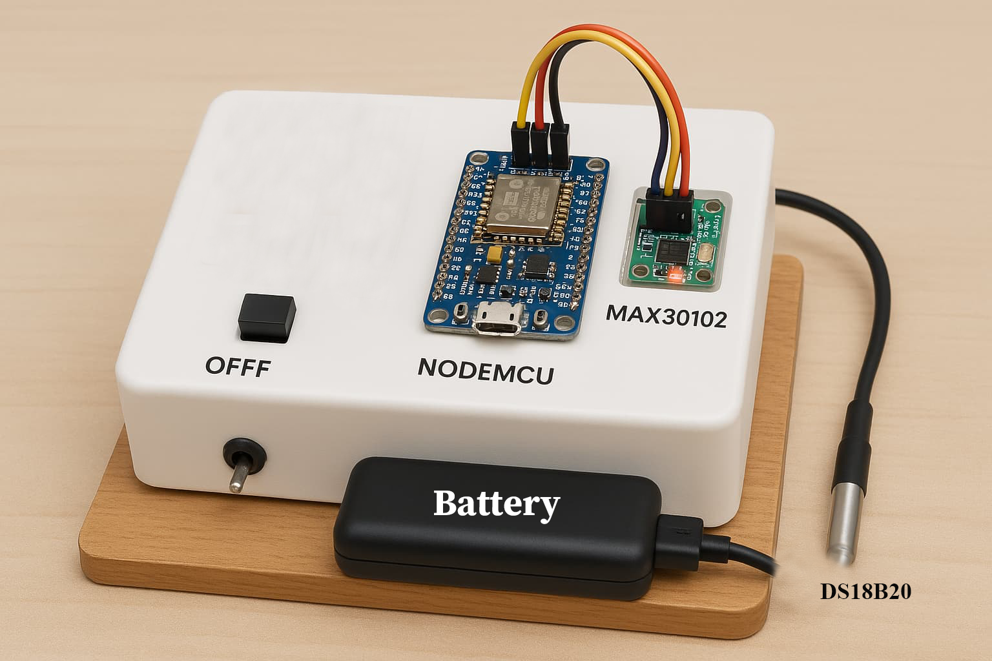
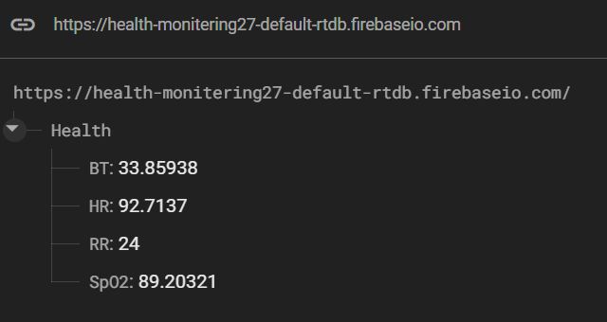
Result
Successfully setup of Iot Hardware and Configuration
Successfully upload sensors data to firebase

Slide 9
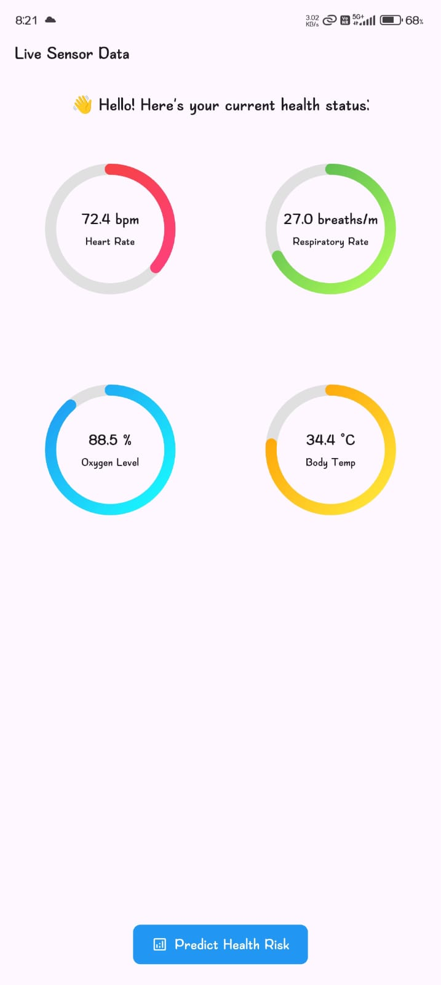
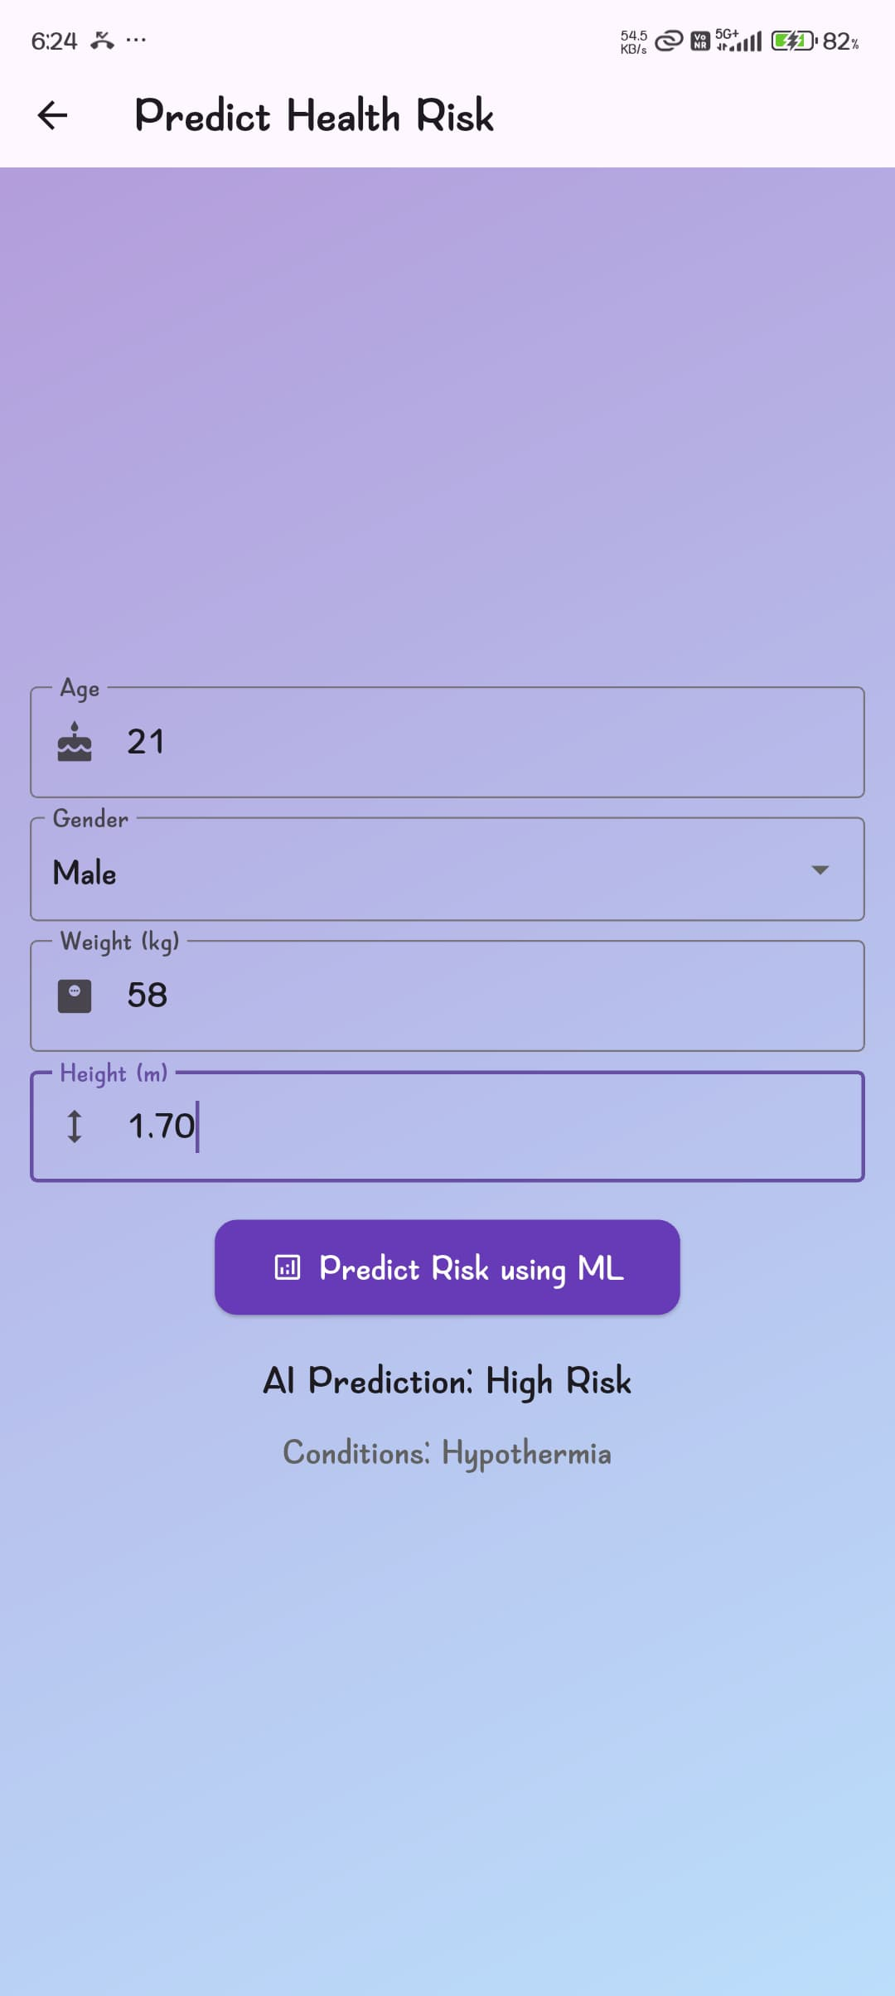
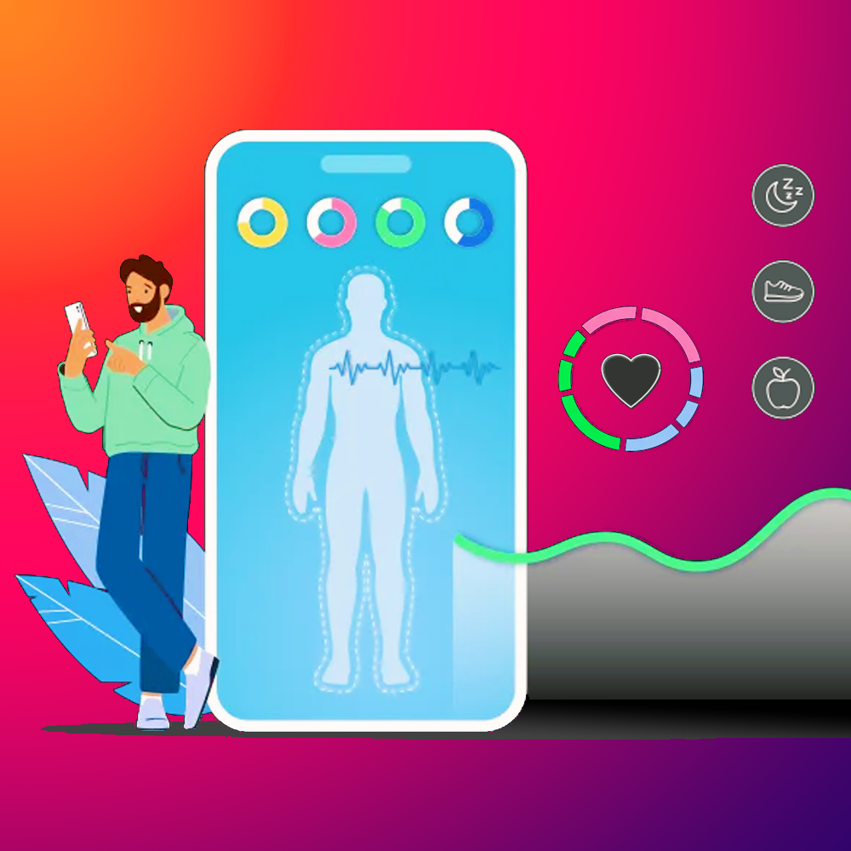
App Icon
Successfully fetch live data from Firebase Server
Successfully predict health from ML model from Flash API hosted on Render

Slide 10
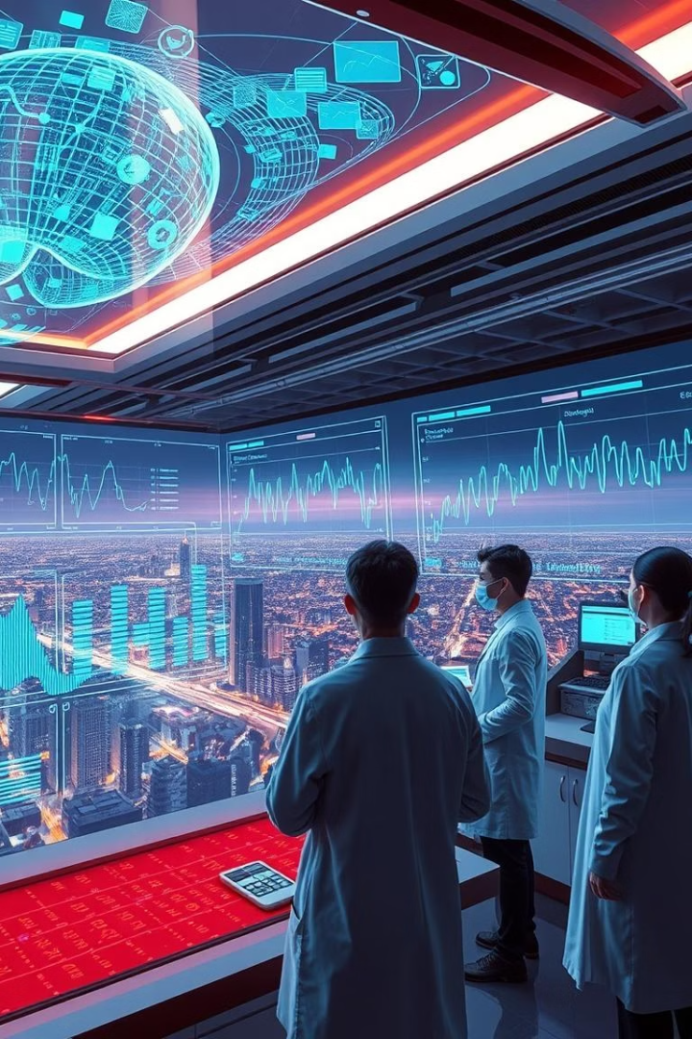
Conclusion
The Health Monitoring System provides an efficient way to measure vital signs and predict health risks using IoT and machine learning. It combines sensor-based data collection, real-time cloud integration, and intelligent prediction, making healthcare more accessible, personalized, and proactive.

Slide 11
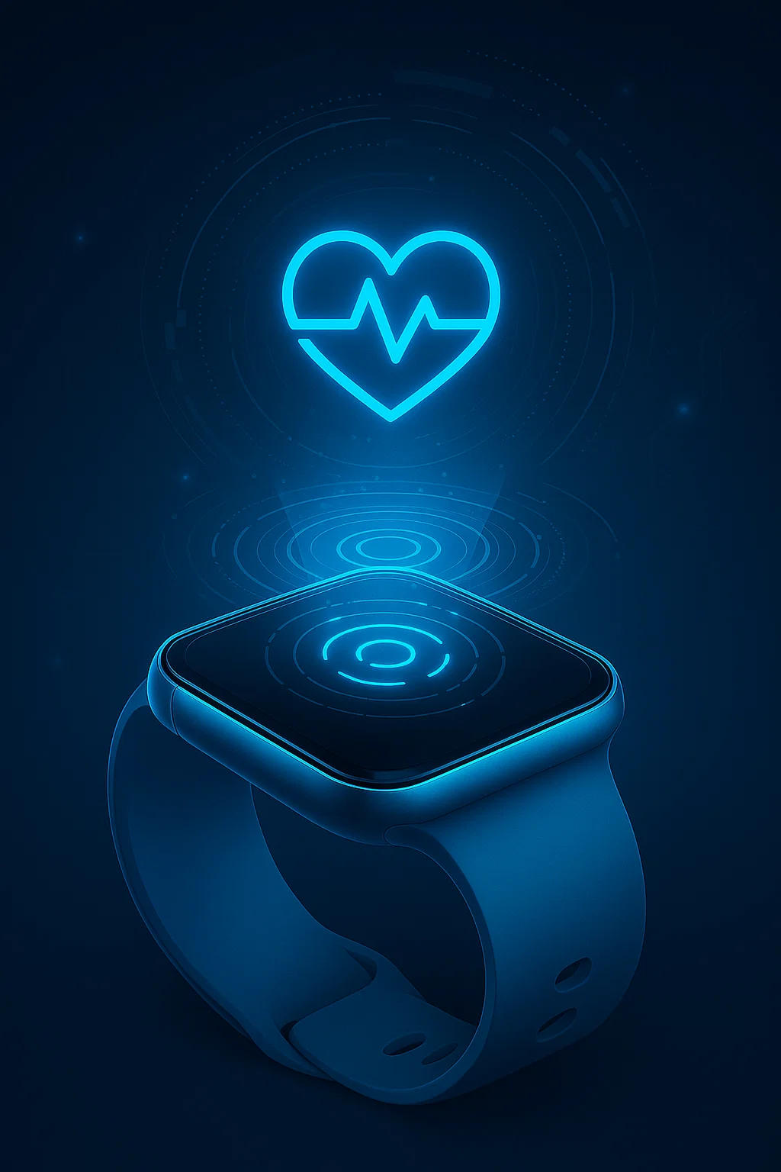



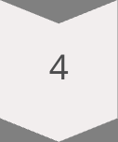

Challenges and Future Work
Sensor Accuracy
Enhance calibration methods for precision.
Data Security
Advance encryption and privacy protocols.
Algorithm Improvement
Develop more robust ML models.
EHR Integration
Connect with electronic health records.
Wearable Devices
Miniaturize sensors for seamless wearables.

Slide 12
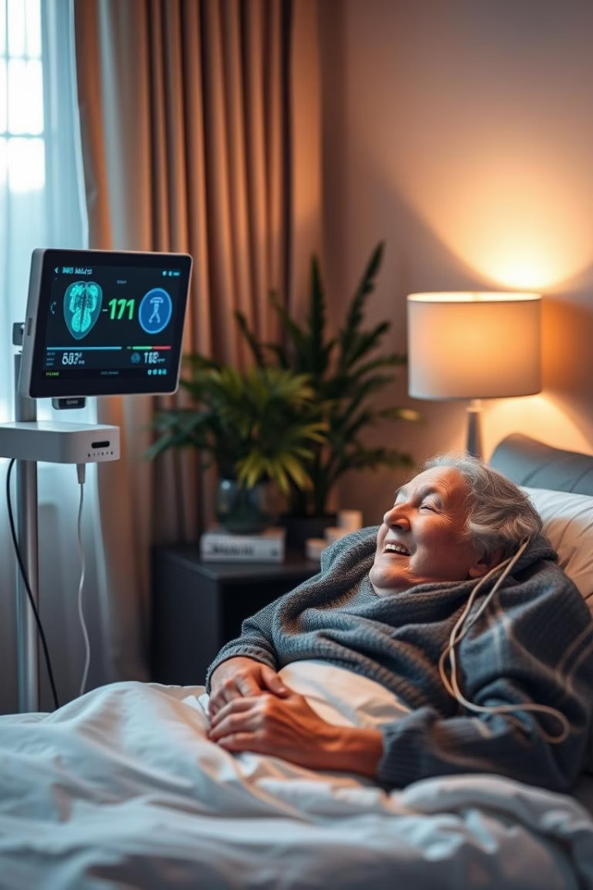
Thank You

